Slide 1
Claim Adjudication & COB

Slide 2
Claims Data Requirement
Data to be present in Claim submission:
Member Information
Provider Information(Billing & Servicing Provider)
Date of Service
Diagnosis Codes
Procedure Codes
- CPT Codes, HCPCs Codes and Revenue codes
Place of Service
Billed Amount
Assignment of Benefits
Claim Receive Date
COB data

Slide 3
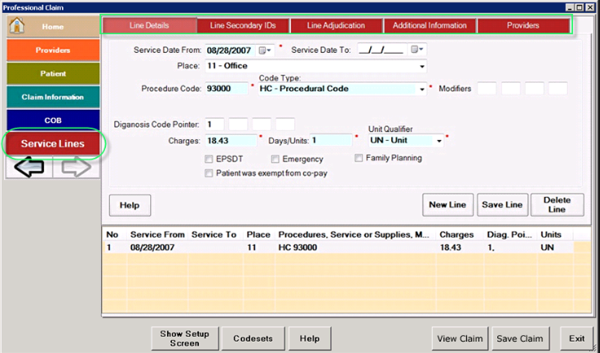
Claim Screen

Slide 4
Claim Adjudication Process
The member information is validated
Member number is validated.
Determination of whether member is suspended or terminated (i.e. DOS > suspense or term date).
Determination of whether this claim is a fraudulent specific member claim.
The provider information is validated
Provider number is validated.
PAR (participating provider) status of Provider is validated.
Provider type is evaluated i.e. if the provider is hospital type or a specialist etc.
Provider name and address is validated.
Check is done for whether Provider is suspended.
Determine if the claim is timely filed
Date of service of the Claim is compared with the received date of the Claim. The difference of the dates is compared with the timely filing limits which is pre-decided based on different types of Provider, types of benefits provided, member category etc. if the claim has not been file within the proper timeframe it is denied

Slide 5
Claim Adjudication Process
Determination of whether the claim is duplicate (by comparing with history)
Here the Date of service of the claim, member no, Provider no, diagnosis code, proc code, Place of service is checked with a history claim for determining duplicity.
Group/plan eligibility is checked
Determination of whether the member is covered under the GROUP, CONTRACT, PLAN, AND PRODUCT which for which the Claim has been filed.
Benefit eligibility is checked
Depending on the Provider type, Place of service and the benefit code of the claim, it is determined if the member is eligible to receive the particular benefit for which claim has been filed.
Determination of whether this is a member reimbursement or provider is already reimbursed
Here a determination is made whether the member has to be directly reimbursed (like in Indemnity Claims) or the provider has to be paid (like an HMO plan). Also this involves a check to see if provider has already been reimbursed for the services e.g. – capitated providers.

Slide 6
Claim Adjudication Process
Verify Referral
Is member number on referral same as on claim?
Is this direct access referral?
Is referral denied?
Validate provider number on referral and provider specialty.
Validate referral dates
Validate referral visit
Validate referral diagnosis
Validate referral procedure
Verify precertification
Precertification is the process of collecting information prior to inpatient admissions and performance of selected ambulatory procedures and services. The process permits advance eligibility verification, determination of coverage, and communication with the physician and/or member.
Note : Once after the claims adjudication is done, then for those validated claims the payment will be made by the insurance company.

Slide 7
Claim Payment Calculation
Claim adjudication is a process in which the actual data on the Claim is compared with the data in the system and based on the business rules or policies the payment of the Claim is decided. The paid amount need not be equal to the billed amount, below is its differences,
Billed Amount:
It is the Amount charged for each service performed by the provider. The billed amount for a specific procedure code is based on the provider.
Allowed amount:
Maximum amount on which payment is based for covered health care services. This may be called “eligible expense,” “payment allowance" or "negotiated rate.“
Paid Amount:
It is the amount which the insurance originally pays to the claim. It is the balance of Allowed amount – (Co-pay / Co-insurance) – deductible.

Slide 8
Claim Payment Calculation
Example:
Consider a member is availed healthcare services, a claim has been submitted by the provider to insurance for the provided medical services,
If the billed amount is $100.00 and the insurance allows $80.00, which is allowed amount, but the payment made for that claim is $60.00 which paid amount.
Formula: -
Paid amount = Allowed amount – (Co-pay / Co-insurance + Deductible)
Paid amount = $80.00 – ($10 copay + $10 Deductible)
= $60.00
So $60.00 will be paid by the insurance company, remaining $20 will be paid by the member.

Slide 9
Output of Adjudicated Claim
Denial letters are sent if :
other insurance paid in full
experimental procedure not covered
Cosmetic surgery not covered
Decision re-reviewed, no change
Explanation of Benefits (EOB)
The Explanation of Benefits provides members a statement of claim payments. It gives the member a detailed explanation of these amounts.
The charges for which the provider has billed the Health Insurance company
The charges which are for services covered by Group Benefits
The charges that the member must pay to meet his/her deductible
The amount the Healthcare Insurance company paid
The amount that the member owes
Billed charges
allowable amount
non-covered amount

Slide 10
Co-ordination of Benefits
COB (Coordination of Benefits): This is the process by which a health insurance company determines if it should be the primary or secondary payer of medical claims for a patient who has coverage from more than one health insurance policy.
Prevent duplication of benefits when a person is covered by two policies
The primary policy pays all the benefits it normally would, and if there are any expenses not covered by the primary policy but covered by the secondary policy, the secondary policy pays additional benefits. In this way, no benefits in excess of the actual expenses incurred are paid.
For Example :Amelia is covered by both her father’s and her mother’s employer-sponsored group health insurance policy. Amelia receives healthcare services costing $1,000, all of which are covered by both policies. Her father’s policy has 30 percent coinsurance, so it pays $700. Her mother’s policy has 20 percent coinsurance, so it pays $800. But both policies have COB provisions, and the father’s policy is the primary policy. So the father’s policy pays $700 (the normal benefit), and the mother’s policy pays $100

